Slide 1
Biofeedback Device in Stroke Rehabilitation
Presented by: Olivia Williams
Team Members: Galen Cheng & Chris Zhang

Slide 2
Outline
Project Introduction
Background
The Need
Project Scope
Design Specifications
Existing Solutions
Team Responsibilities & Design Schedule

Slide 3
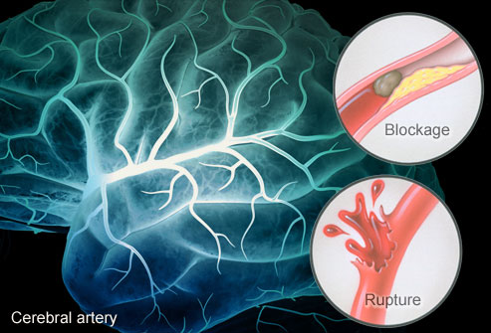
Background
Notes:
Image: https://www.webmd.com/stroke/ss/slideshow-stroke-overview
affecting around 800,000 people in the US every year and killing around 140,000 Americans every year (Yang et al.; Benjamin et al.). While these numbers demonstrate the immense significance of stroke, they also provide a vast market for stroke related devices.
Stroke commonly falls into 2 categories: ischemic and hemorrhagic.
Ischemic -- blood clot
Hemorrhagic -- rupture in the artery

Slide 4
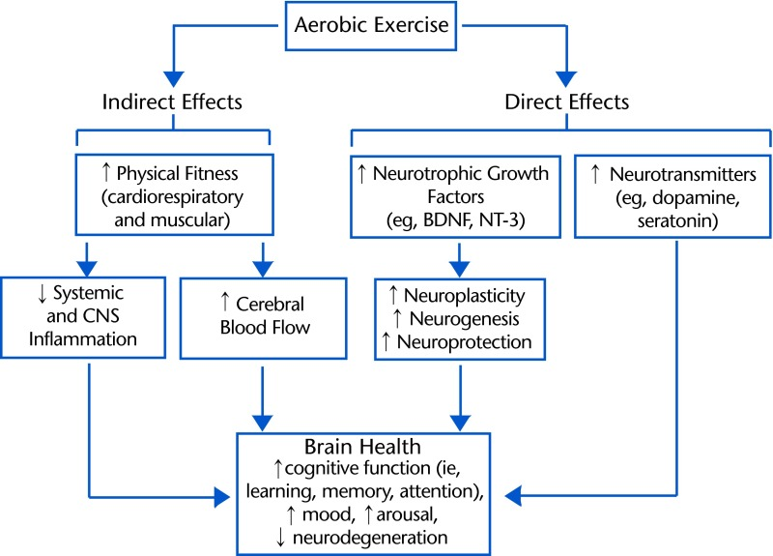
Background
Lasting impact of stroke
Time dependent
Common deficits - motor impairments
Spasms
Incoordination
Hemiparesis
Dumbness
75% of stroke survivors experience upper extremity impairments
Mang CS. Promoting Neuroplasticity
Notes:
https://www.ncbi.nlm.nih.gov/pmc/articles/PMC3870490/figure/F1/
To regain those lost functions, the brain must rewire the remaining healthy parts to compensate for the damage. Neuroplasticity, which is the ability of the central nervous system (CNS) to undergo structural and functional change in response to new experiences, modulates this process. Physical therapy helps the brain reconfigure itself through motor rehabilitation, a form of motor learning that refers to a relatively permanent change in motor behavior caused by extensively repetitive practice

Slide 5
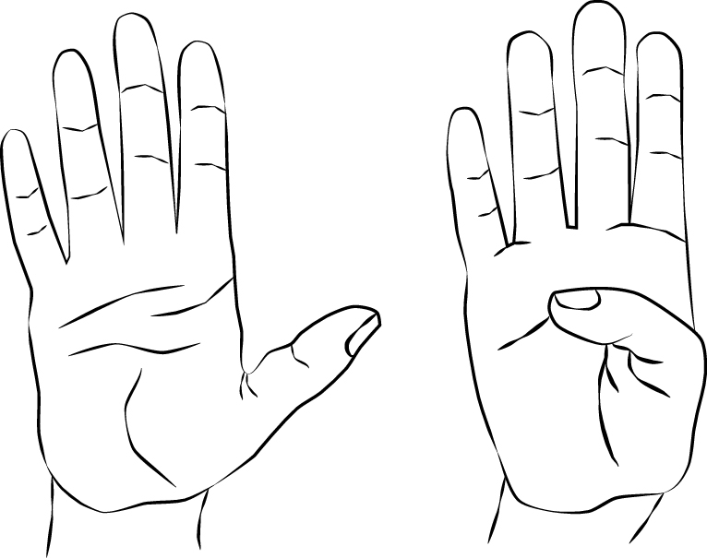
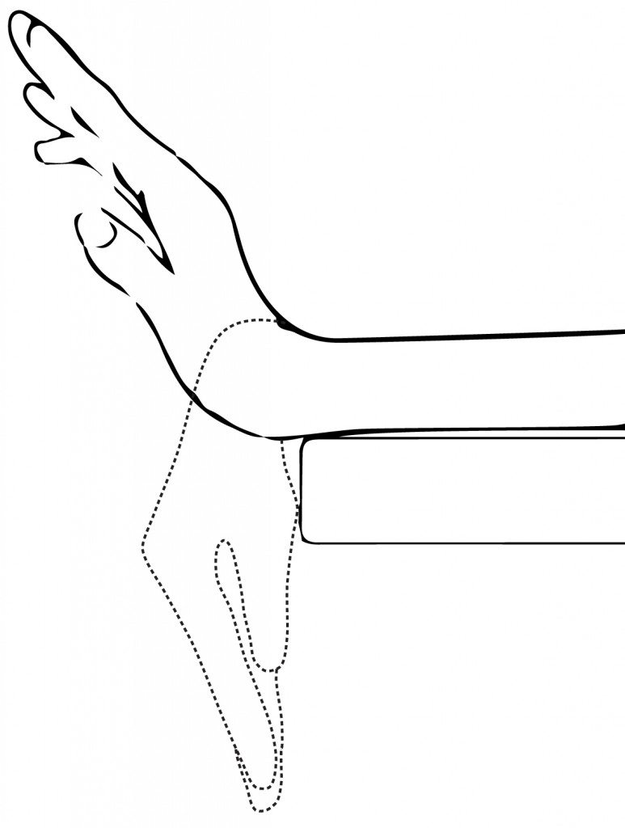
The Need
Notes:
Images: https://www.flintrehab.com/2015/hand-therapy-exercises-after-stroke/
Introduce clinet (Dr. Carter) here

Slide 6
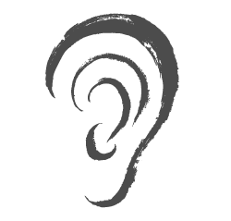
The Project Scope
Notes:
“Given the lack of biofeedback currently utilized for upper extremity rehabilitation, there is a need to provide visual, auditory, and/or tactile biofeedback for rehabilitation among adult patients with a recent stroke that will strive to improve rehabilitation success rate and speed of recovery.”

Slide 7
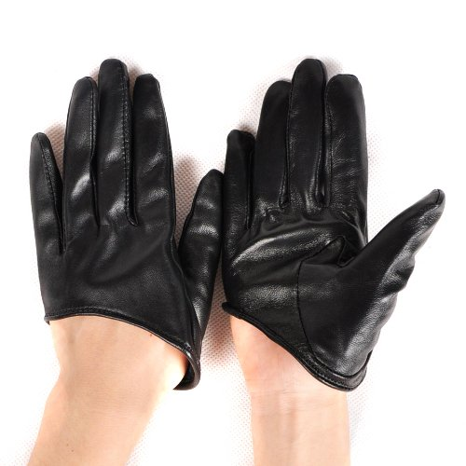
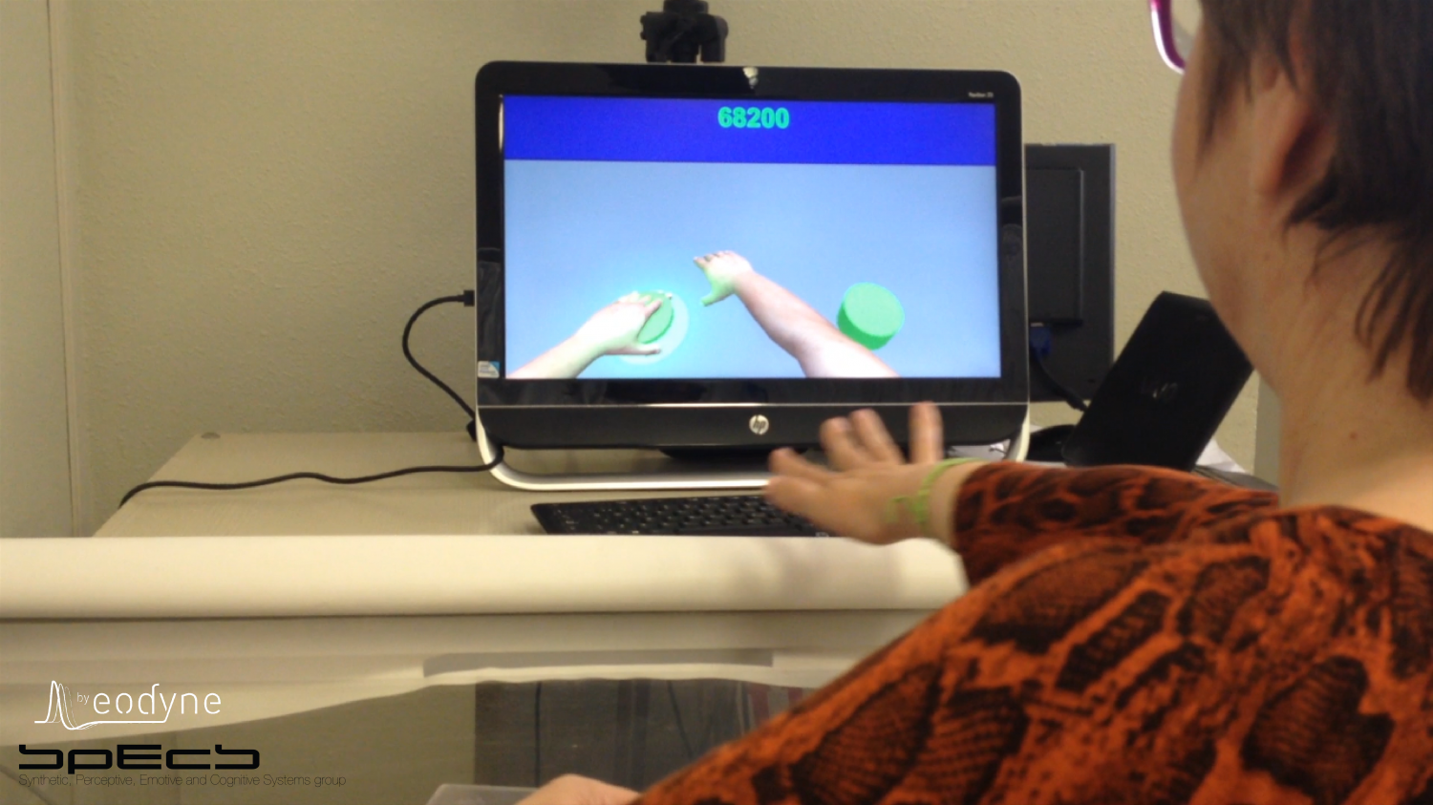
Design Specifications
Notes:
Hemi-glove: find a picture
State all 8

Slide 8
Specifications
Size: 65cm x 35 cm x 15 cm in order to fit into a packpack
Weight: less than 20 lbs with no more than 0.2 kg touching patient
Budget: $2000
Safe: won’t worsen patient’s condition
Use: Right-handed device detecting 10 degree displacement
Feedback: provides visual, auditory, or tactile with delay of less than 100 ms
Power Source: enough to last for 30 min during session
Durability: device will last at least 1 month and cleanable if in contact with patient
Comfortable: won’t cause chafing or pain due to swelling
Tasks: difficult enough so when utilized, 70% patient success rate with exercises given repetitive practice
Engagement: patient engaged for at least 20 min
Setup time: less than 5% of overall therapy time

Slide 9
Existing Solutions

Slide 10
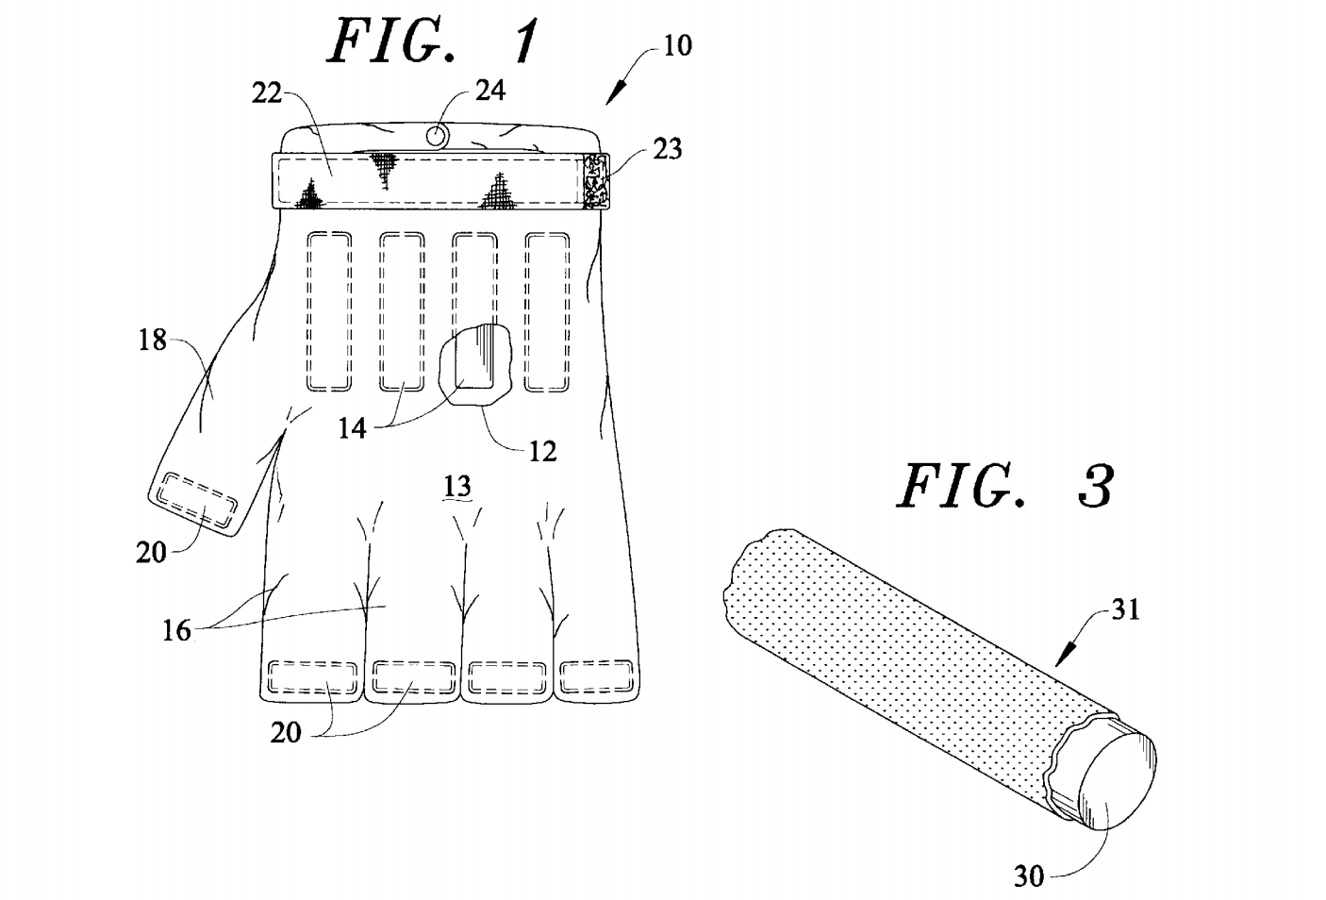
Music Therapy
Exercise Therapy
Robot-based Solutions
Wearable Sensor
Motion Recognition
Notes:
Image: file:///Users/leah628/Downloads/US5768710.pdf
Videos: http://www.virtualrehab.info/

Slide 11
Table 1. Rehabilitation therapy characteristics (Wang et al.).
 | Music Therapy | Exercise Therapy | Motion Recognition Systems | Robot based solutions | Wearable-sensor based systems
Feedback | Auditory | Tactile | Visual, Audio | Tactile | Visual, Auditory, and/or Tactile
Technical Assistance | Not Required | Not Required | Required | Required | Required
Relative Cost | Low | Low | High | High | High
Power Source | N/A | N/A | Required | Required | Required
Relative Weight | Variable | Light | Medium | Medium | Very Light

Slide 12
Team Responsibilities
& Design Schedule

Slide 13
